Slide 1
Deep learning-based wind-induced building damage classification
ECE 9603/9063B: Data Analytics
Course project
By: Group 7 Aaron John,
Abiy Melaku, and
Tsinuel Geleta
Presented to: Prof. Katarina Grolinger
The University of Western Ontario
Nov 25, 2021
London, Ontario, Canada

Slide 2
Outline
Introduction
Description, motivation and importance of the problem
Review of existing approaches
Objectives
Methodology
xBD: A building damage assessment dataset from satellite imagery
Application of CNN for damage classification
Training, validation, tuning, and evaluation of the CNN model
Results
Summary
Presenter: Tsinuel Geleta

Slide 3
Introduction
Presenter: Tsinuel Geleta

Slide 4
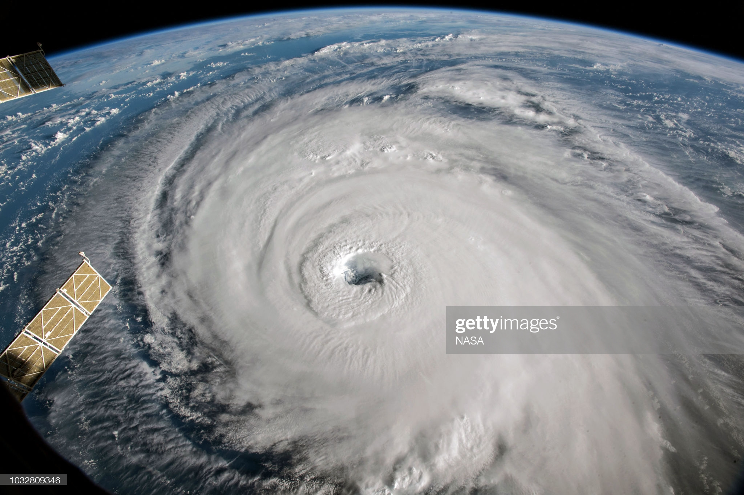
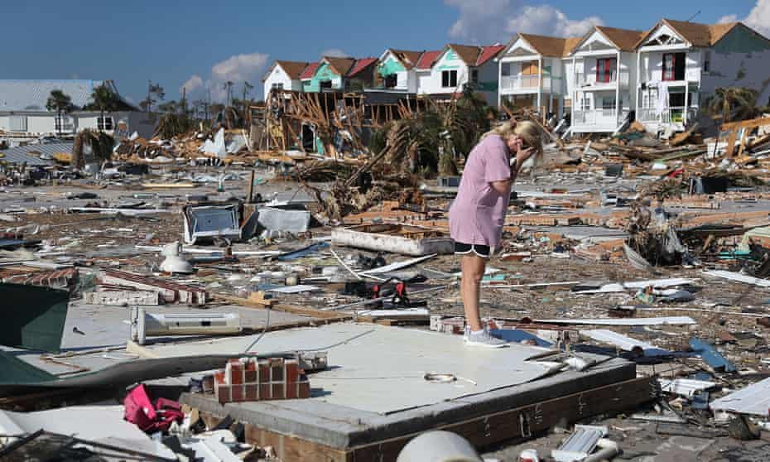
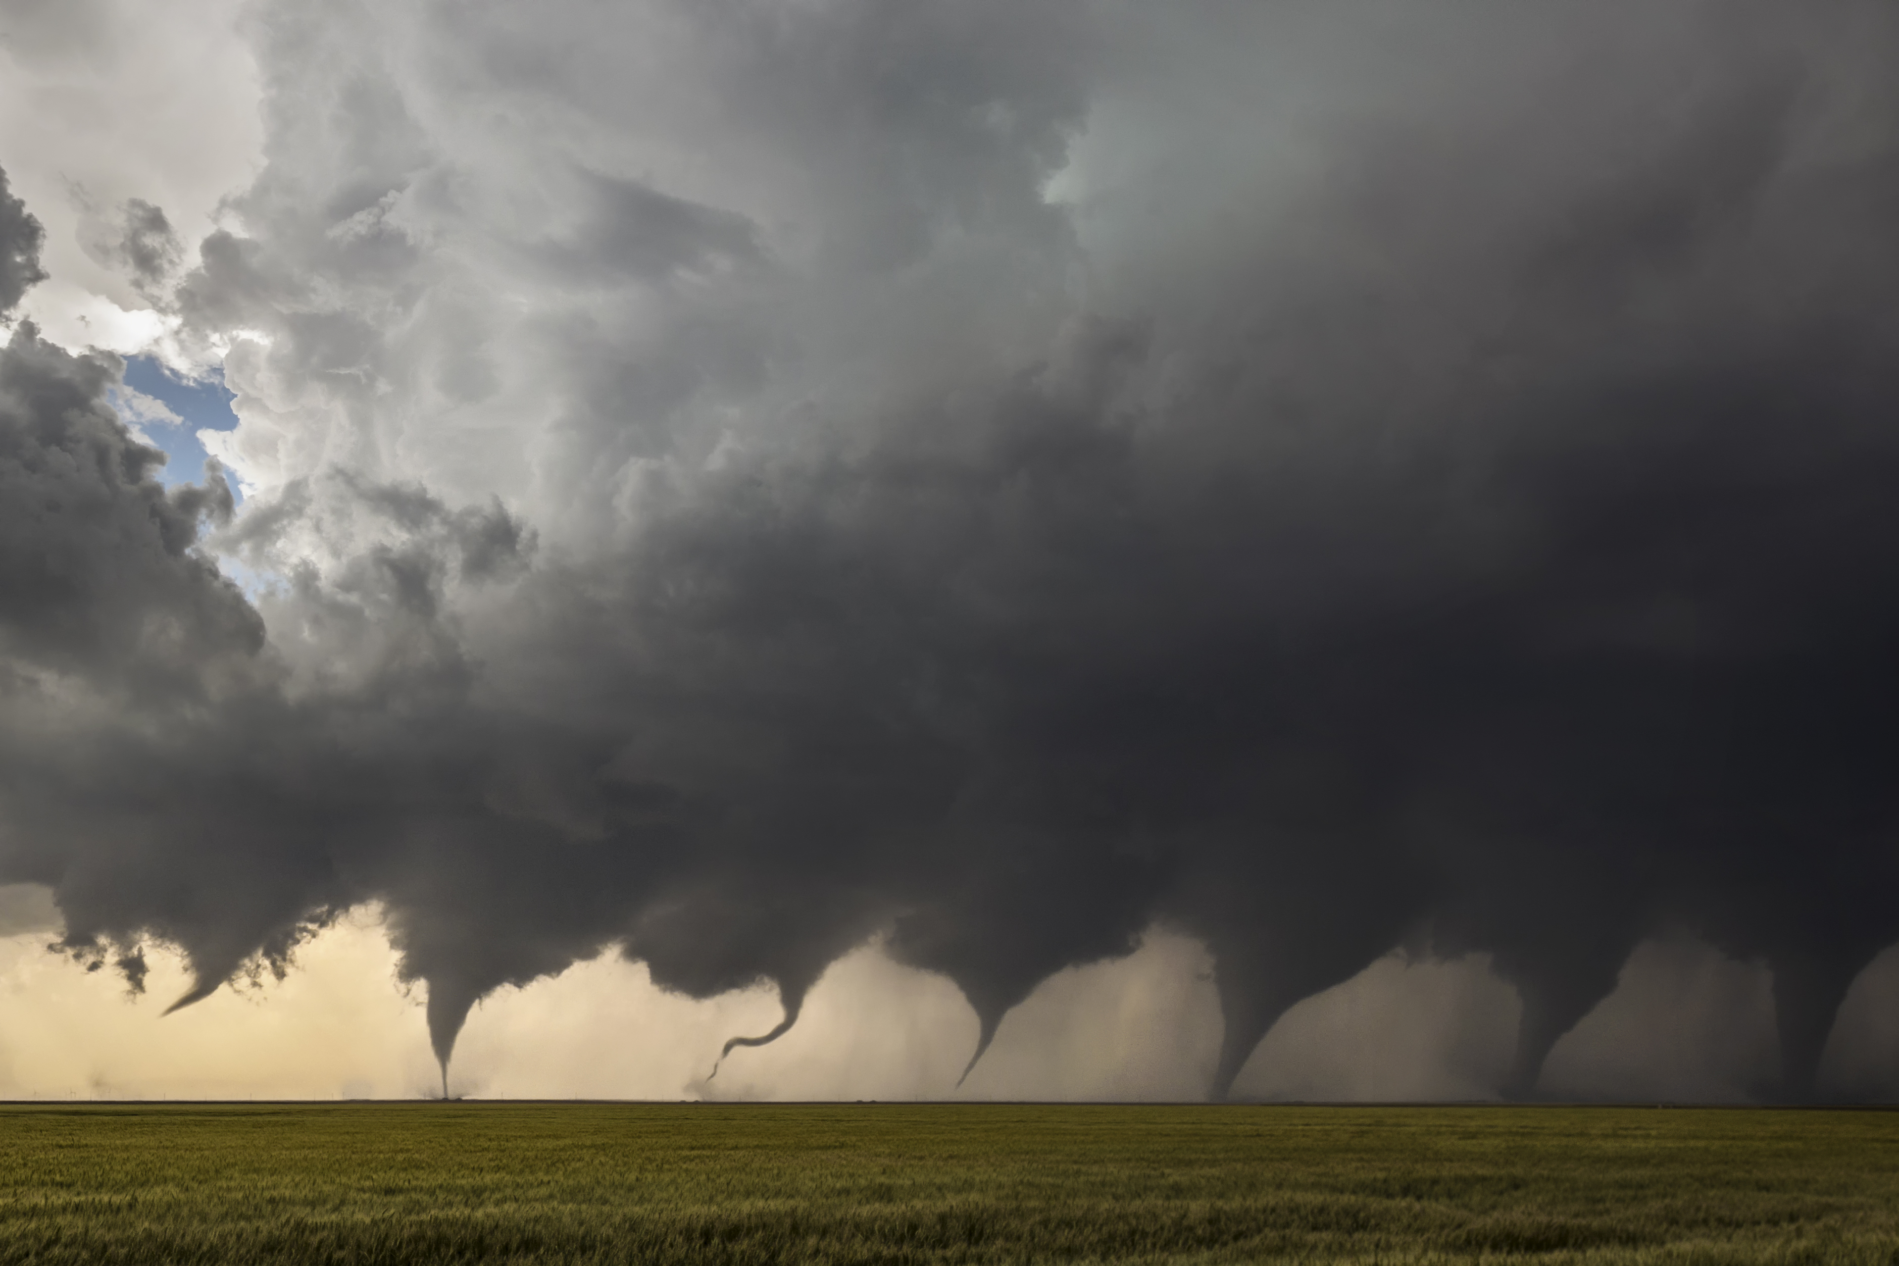
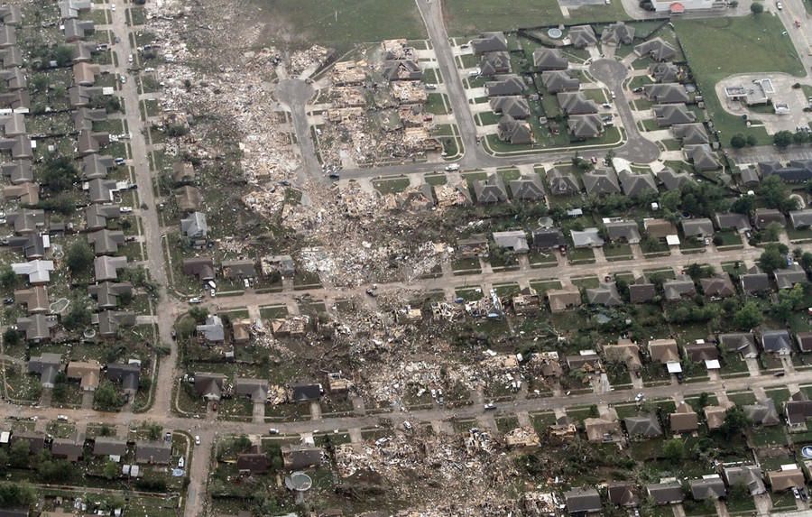
What is wind-induced damage?
Hurricanes/typhoons
Hurricane Florence, 2006
Source: Getty Images, NASA
Hurricane Michael, 2018
Source: Joe Raedle/Getty Images
Tornados
Kansas, 2016
Source: https://en.wikipedia.org/wiki/Tornadogenesis
Moore Tornado, 2013
Source: AP Photo/Steve Gooch

Slide 5
Why is wind-induced damage assessment important?
Because:
Wind-induced damage of buildings lead to one of the largest loss of lives and livelihoods.
Understanding past events helps us mitigate future ones.
Emergency response and planning depends on understanding the extent.
Annual hurricane loss in U.S.
Source: NOAA
Source: NOAA; US National Weather Service; ID 203694
https://www.statista.com/statistics/203694/number-of-fatalities-caused-by-tornadoes-in-the-us/
Presenter: Tsinuel Geleta

Slide 6

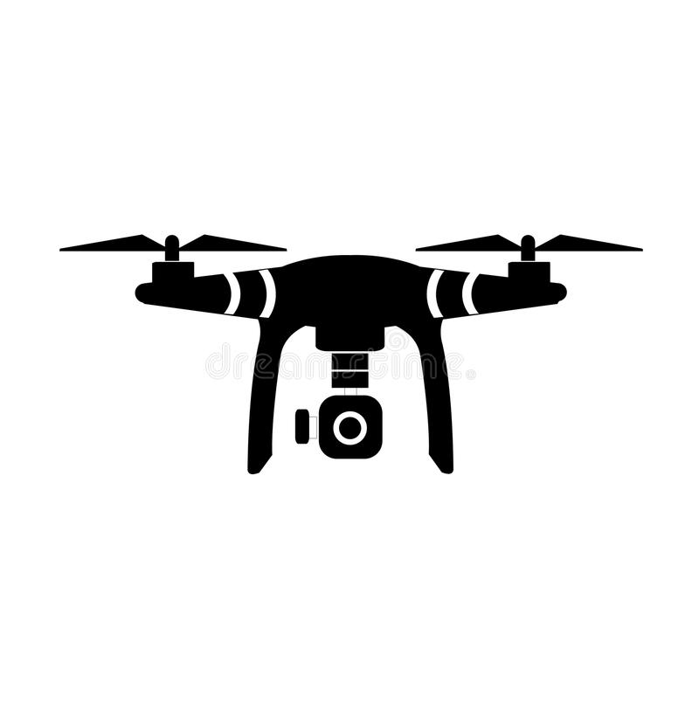
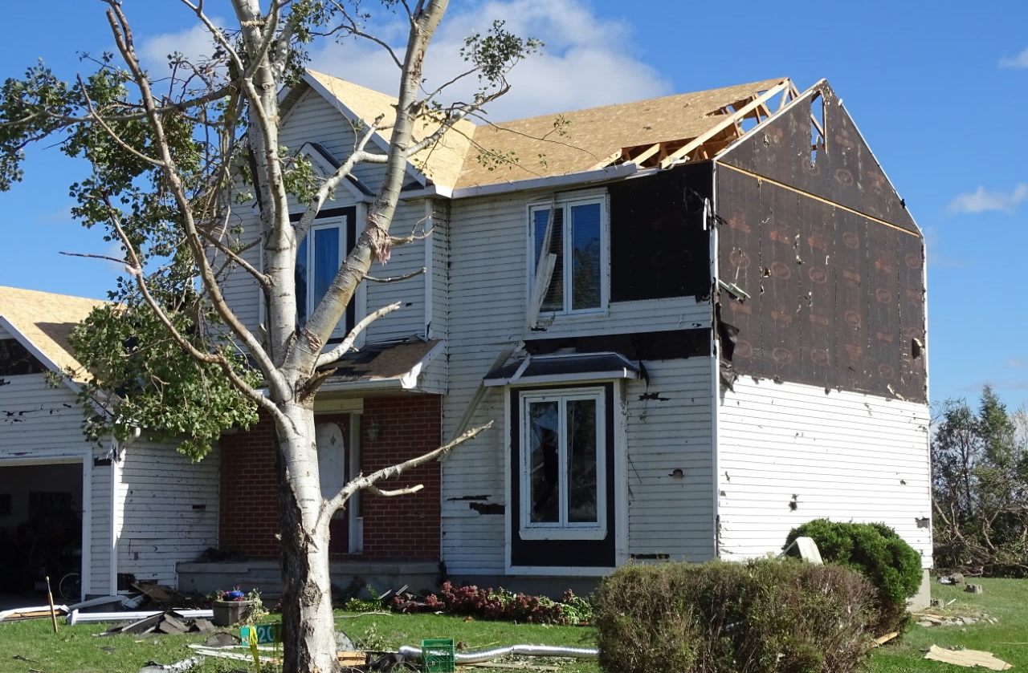
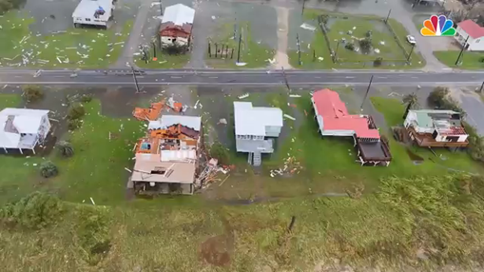

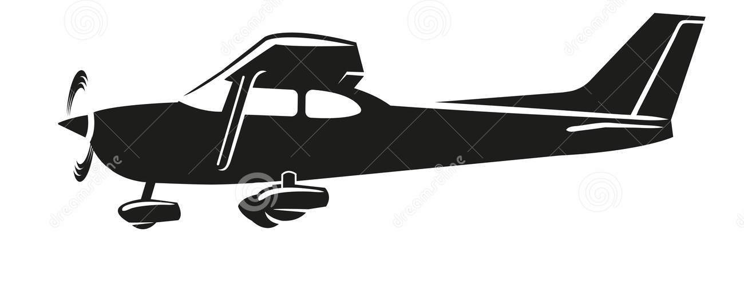
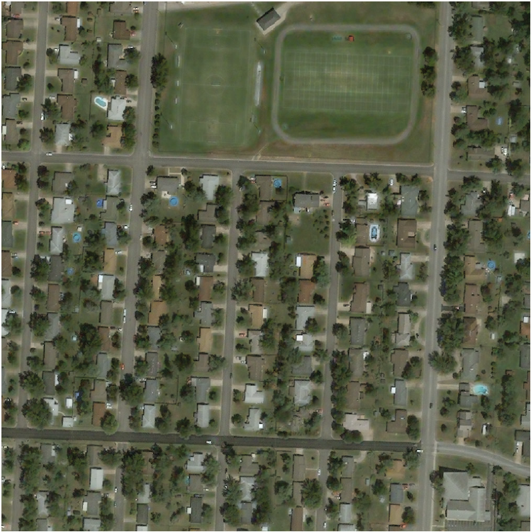
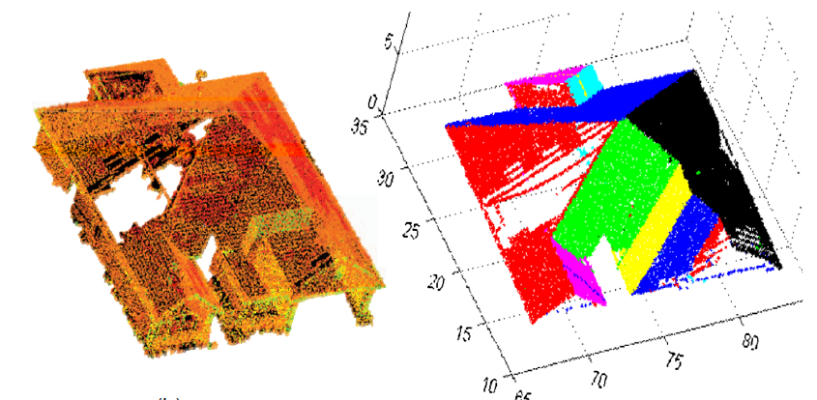
How is damage assessment conducted?
Data collection
Ground survey
Drone imagery and footage
Resolution: 0.3 to 1m
Can be quick
Versatile amount of details
Resolution: *varies*
Slowest to collect
High amount of details
Source: Northern Tornados Project
Source: MSNBC News agency
High-altitude aerial imagery
Other technologies: e.g., Lidar
Resolution: 1 to 2m
Quickest to collect
Low amount of details
Rare
The most robust
Difficult to widely apply
Keshani et al. (2016)
Gupta et al. (2019)
Presenter: Tsinuel Geleta

Slide 7
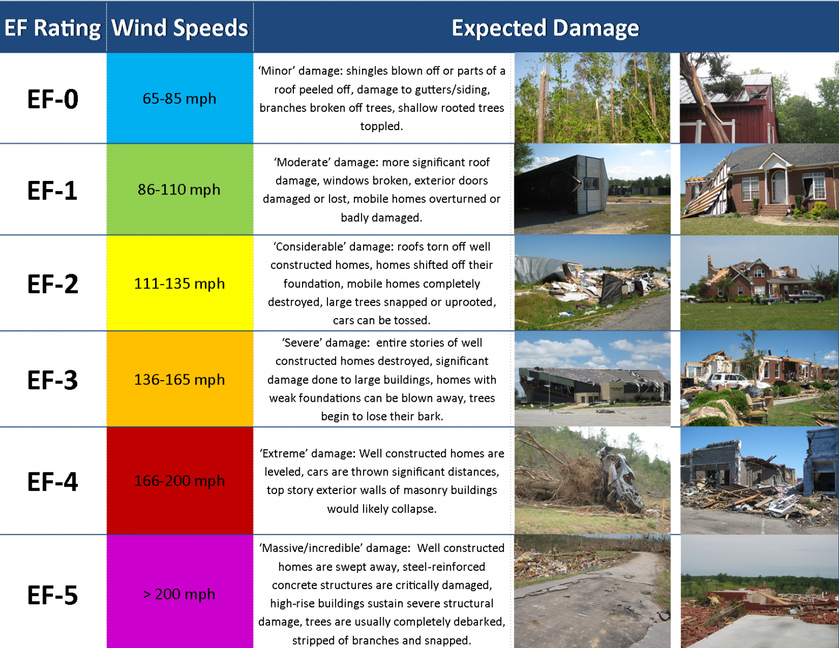
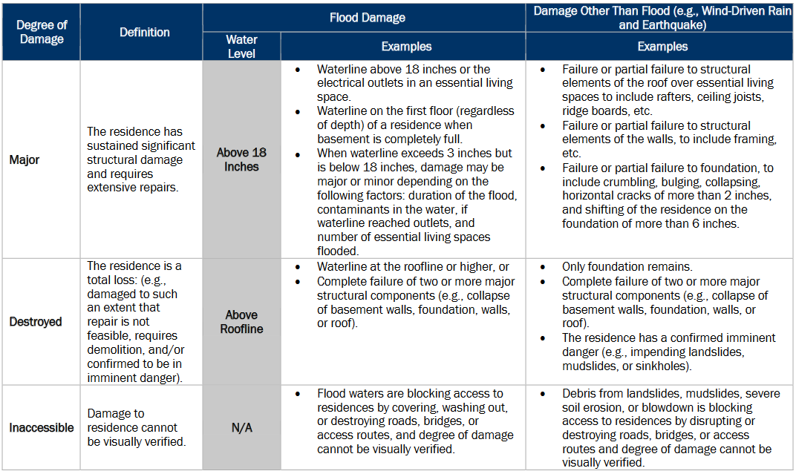
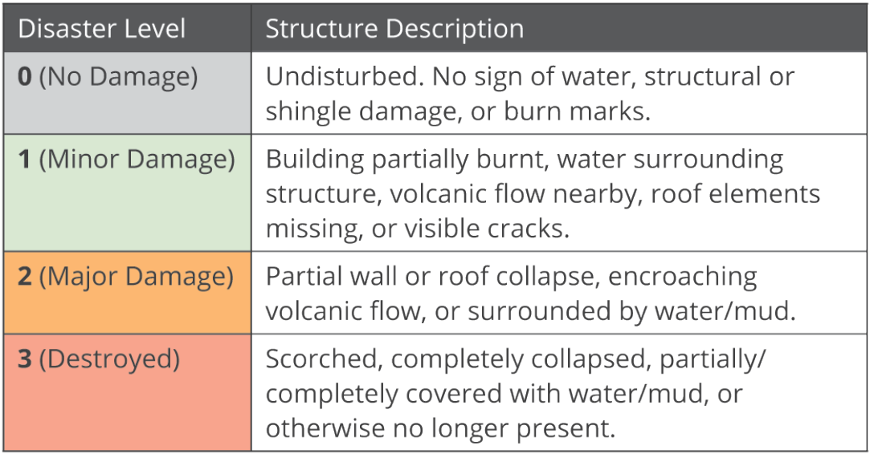
How is damage assessment conducted?
Data processing: assign a damage level by matching the observed damage to a pre-defined damage scale
Tornado EF scale damage indicators
FEMA Degree-of-damage definitions
Simplified general indicator
Gupta et al. (2019)
Source: FEMA (2020)
Source: National Weather Service
https://www.weather.gov/ohx/20130113
Presenter: Tsinuel Geleta

Slide 8
What are the challenges in post-damage assessment?
Current methods of manual processing are:
Slow – for ground survey
Aerial imagery is faster – difficult to process manually
A promising solution:
Computer vision (i.e., Deep learning)
Fast
Can incorporate new technologies
Presenter: Tsinuel Geleta

Slide 9
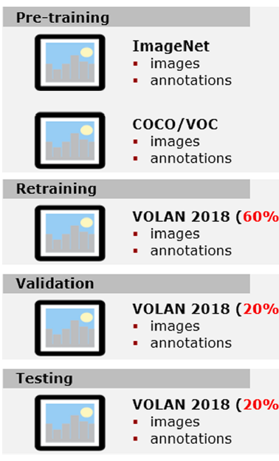
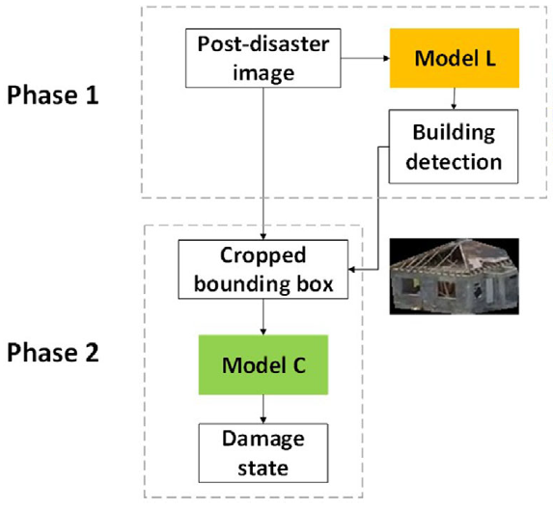
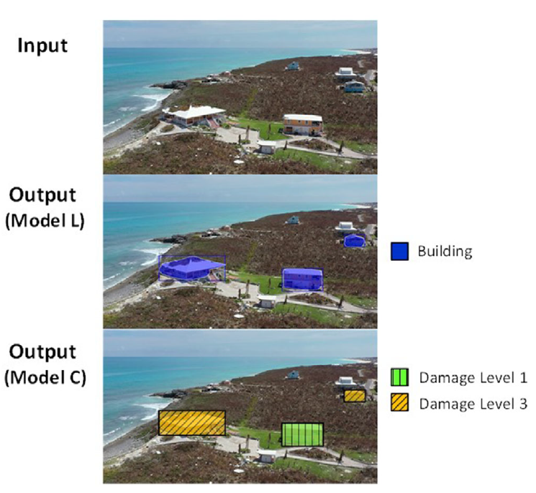
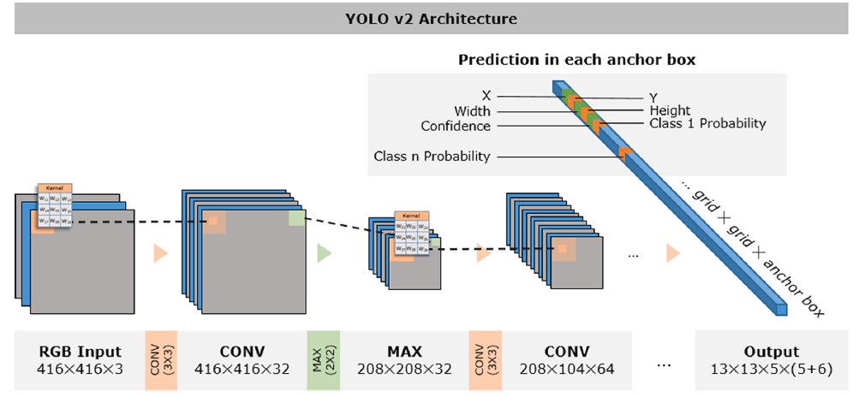
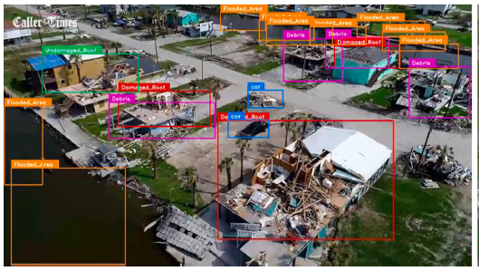
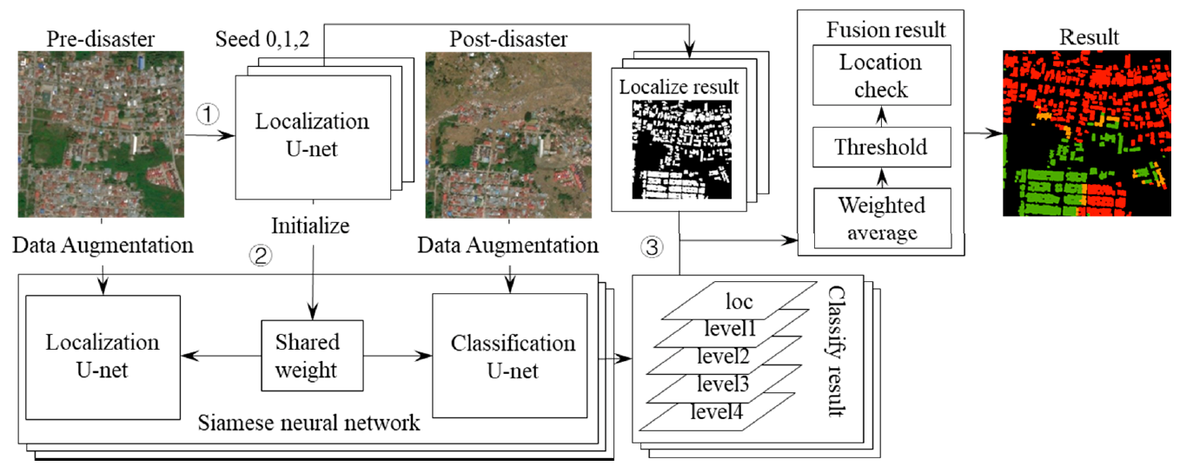
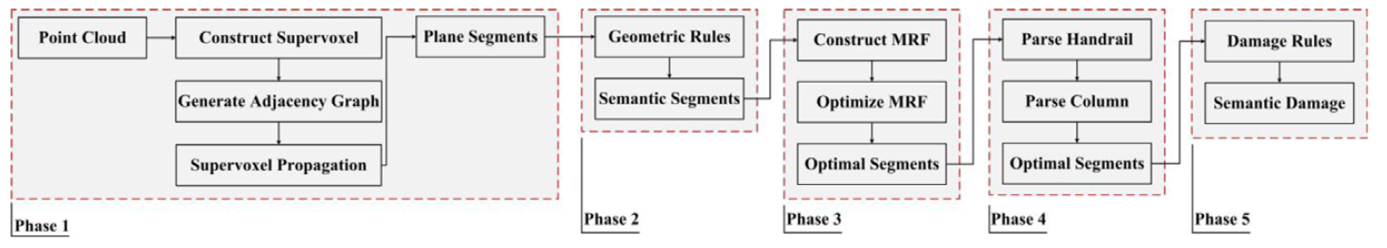
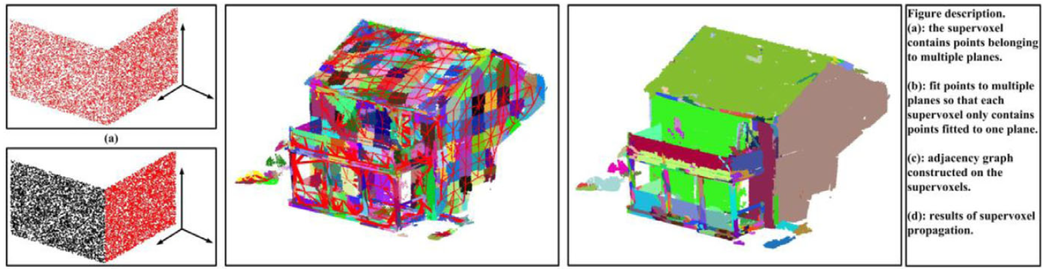
Studies on use of DL for damage classification
Cheng et al. (2021)
Pi et al. (2020)
Video from drone & helicopter
Transfer learning (ImageNet, COCO/VOC)
Accuracy: 80.7% (helicopter); 74.5% (drone)
← RetinaNet
MobileNet →
Drone footage
Transfer learning (RetinaNet, MobileNet)
61% accuracy
Lidar measurement
Component level damage
Accuracy: 78 – 82%
Zhou and Gong (2018)
Wu et al. (2021)
Aerial imagery
Transfer learning (U-net)
F1 score of 0.792
Presenter: Tsinuel Geleta

Slide 10
Objective
To apply CNN for building damage classification from high-altitude aerial imagery
Presenter: Tsinuel Geleta

Slide 11
Methodology
Presenter: Aaron John

Slide 12
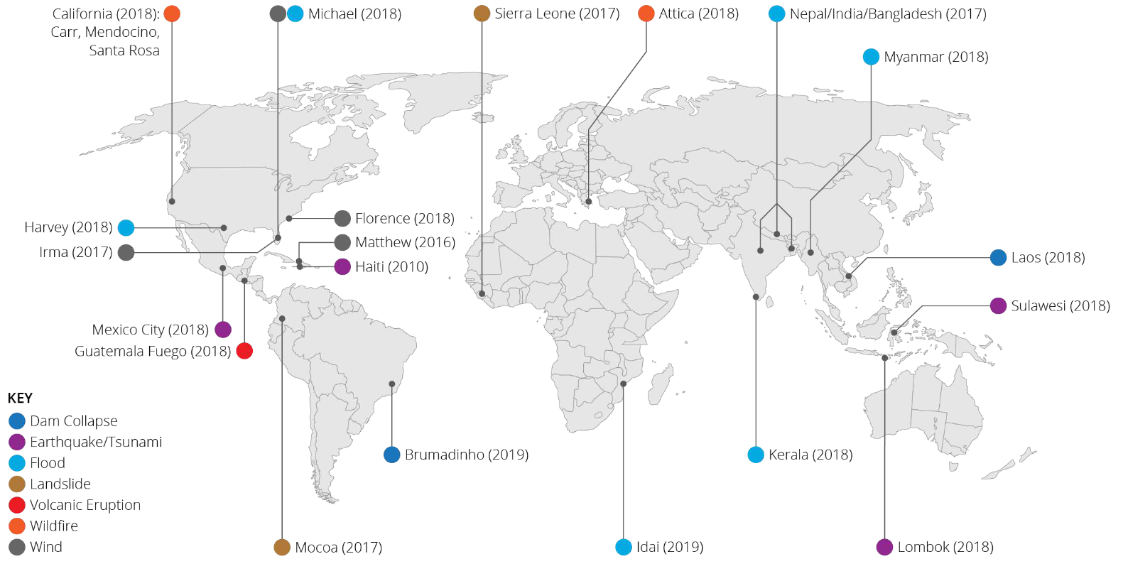
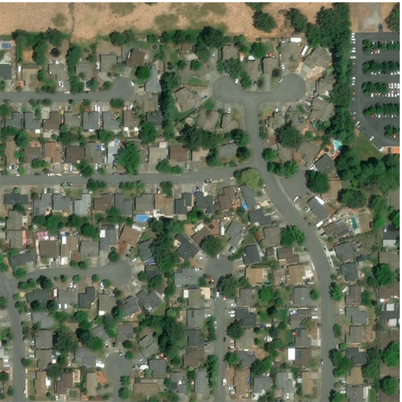
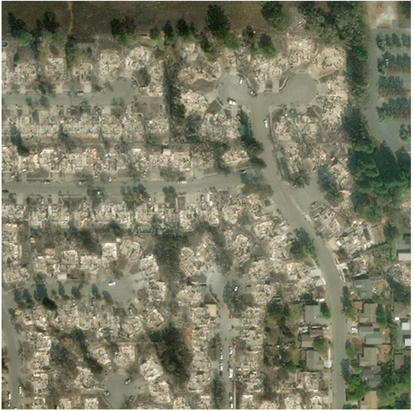
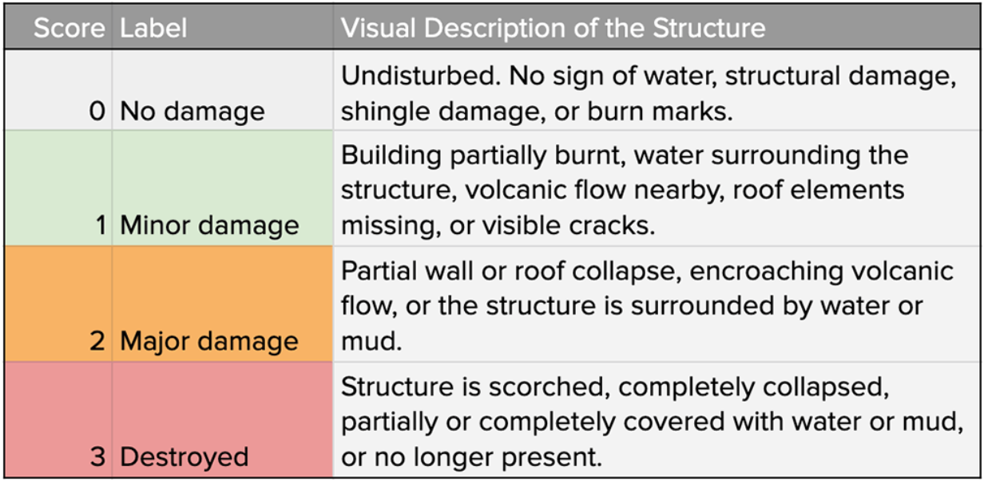
Data pre-processing: xBD database by Gupta et al. (2019)
Presenter: Aaron John
https://www.xview2.org/

Slide 13
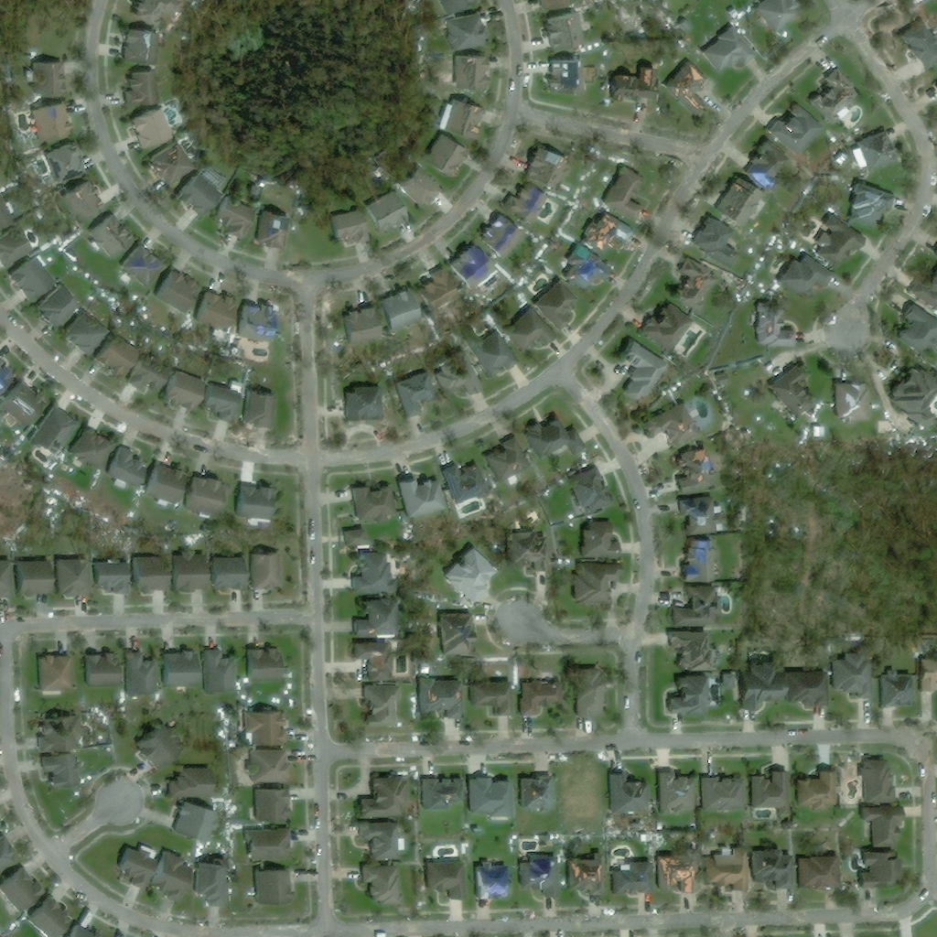
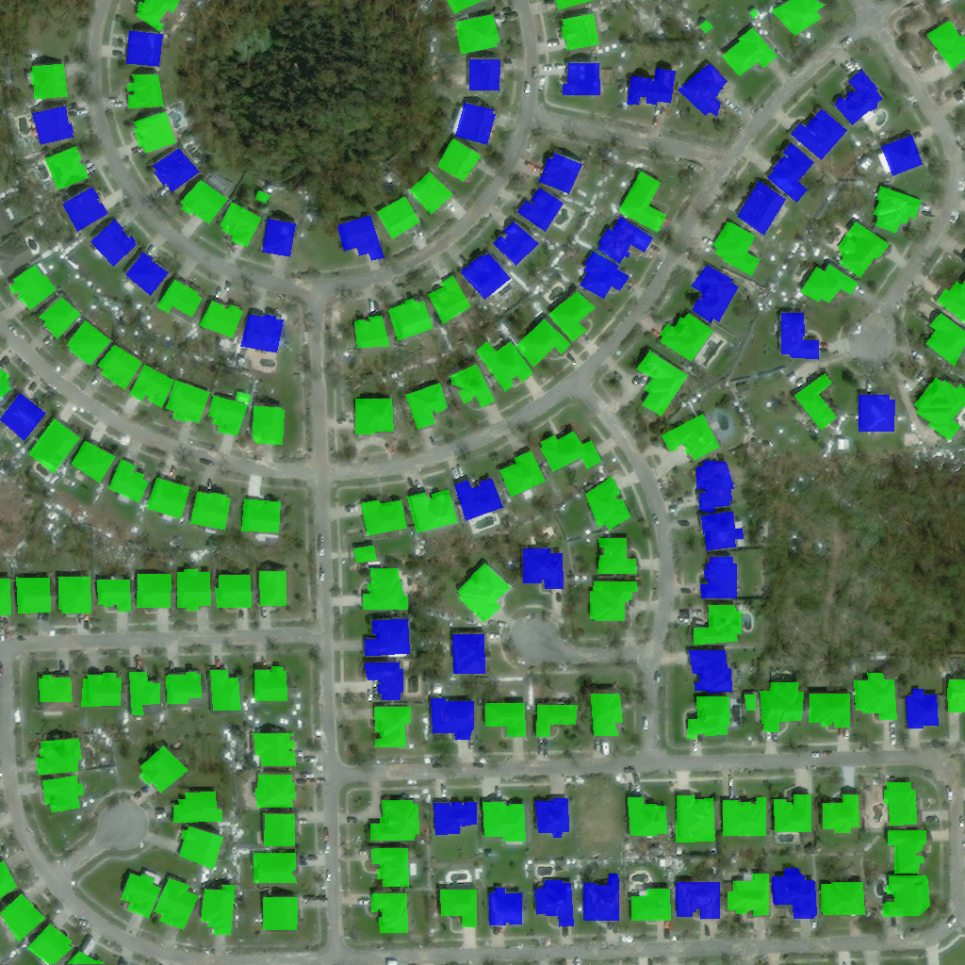
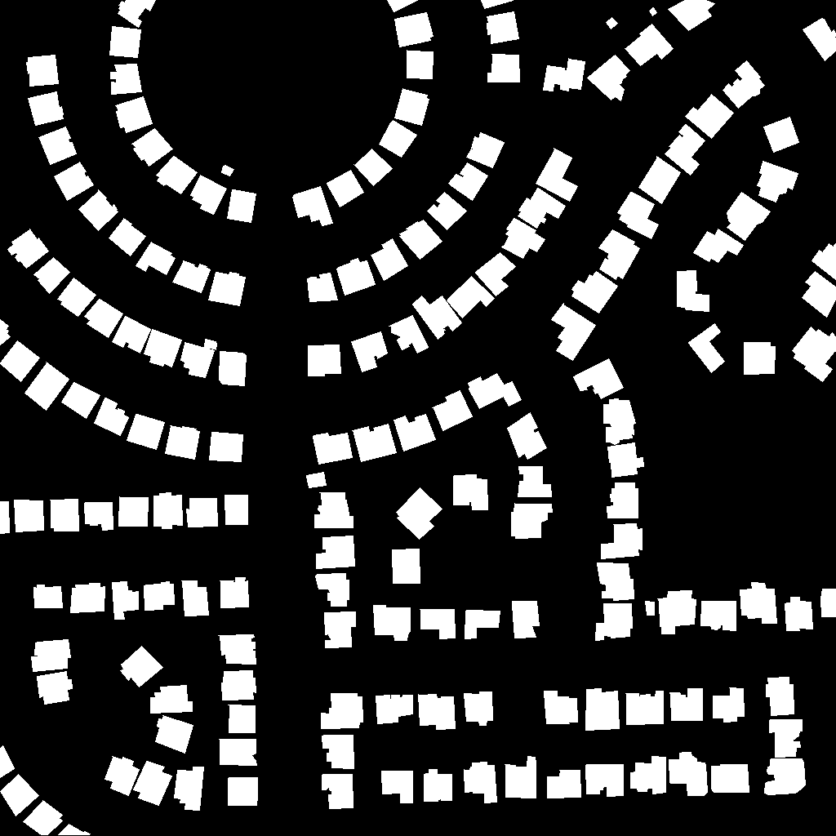
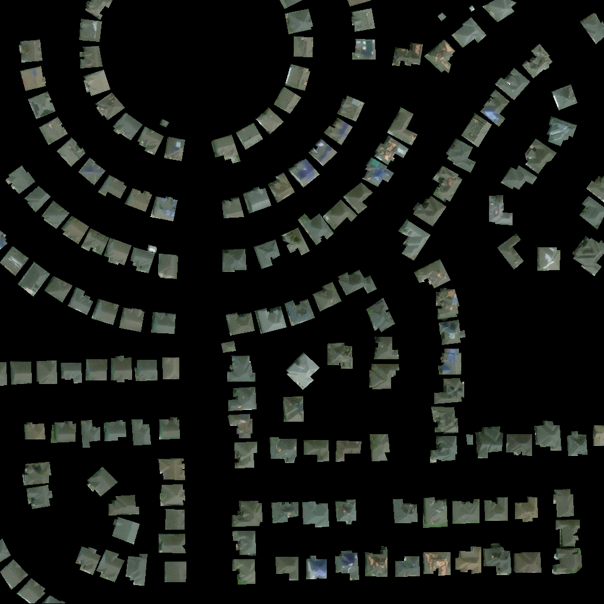










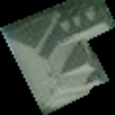


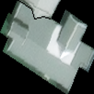









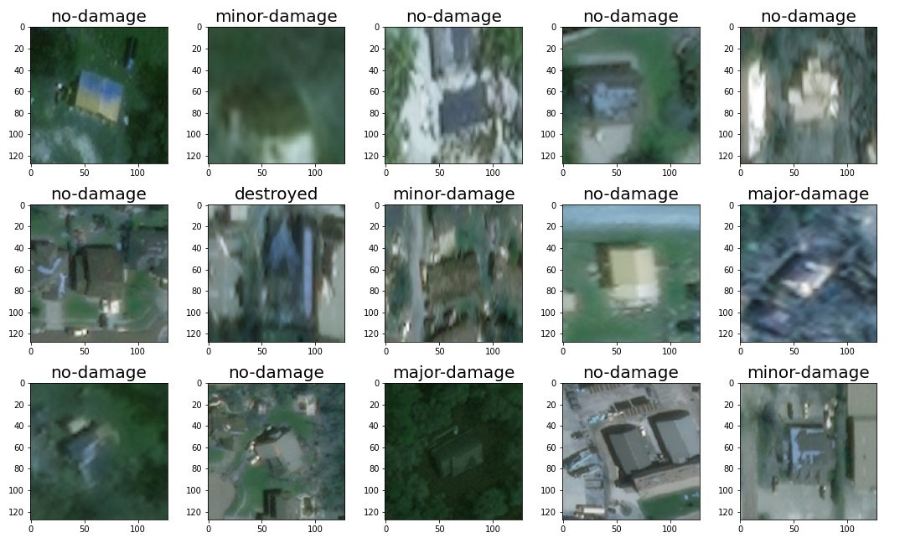
Data pre-processing: building segmentation
Plain pre- and post-disaster images
Retrieve building polygons
Create masking based on building polygon
Apply masking to the original image
Split masked image into individual buildings
Resize all images to 128 x 128
A total of ~20k buildings are extracted
…
Presenter: Aaron John

Slide 14
Data pre-processing: preparation of data for CNN model
…
…
…
…
…
Training 80%
Validation 10%
Testing 10%
Label
…
…
…
…
…
128
128
20k individual buildings with damage state labels
Input data rearranged into batches of 64 to avoid memory issues
Presenter: Aaron John

Slide 15
CNN damage classification model
Max Pooling
Kernel:2x2
Stride:none
Conv2D
Kernel:3x3
Stride:1
Max Pooling
Kernel:2x2
Stride:none
Conv2D
Kernel:5x5
Stride:1
64x64x64
32x32x64
Conv2D
Kernel:3x3
Stride:1
64x64x32
Input
(128x128x3)
128x128x32
ReLu Activation function
32x32x64
Max Pooling
Kernel:2x2
Stride:none
FC Linear
FC Linear
FC Linear
FC Linear
Flatten
One-hot encoding
16x16x64
Output
(4x1)
124x1
524x1
2024x1
16384x1
Presenter: Abiy Melaku

Slide 16
Model training, evaluation, and tuning
Start
Optimizer: Adam
Loss function: Multi-class cross entropy
Get model, loss_func, optimizer, train_set, valid_set, maxEpoch
Next epoch
Next batch
Initialize optimizer
Predict train_y
Calculate train_loss
Back propagate train error
More batch?
Y
Step the optimizer
Y
More epoch?
N
Calculate valid_loss
Predict valid_y
N
Hyper parameters considered in tuning:
Convolution kernel size
Number of convolution layers
Learning rate
Tuning method: grid search
Return model, train_loss, valid_loss
End
Presenter: Abiy Melaku

Slide 17
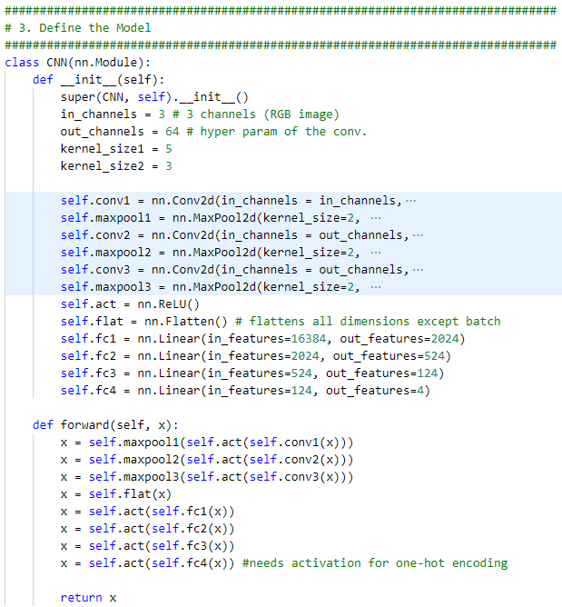
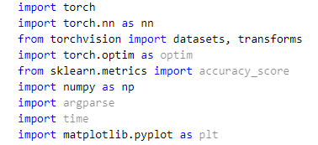
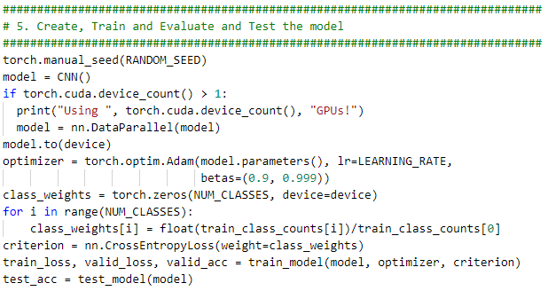
Implementation
Applied packages
Presenter: Abiy Melaku

Slide 18
Results and Discussion
Presenter: Abiy Melaku

Slide 19
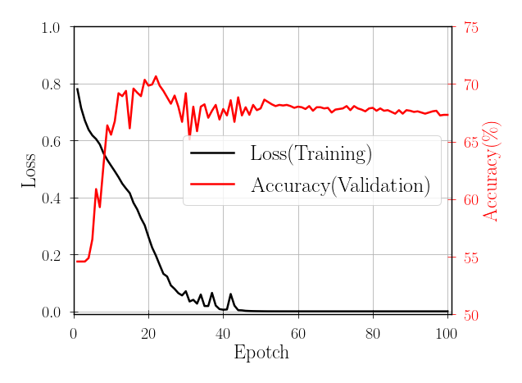
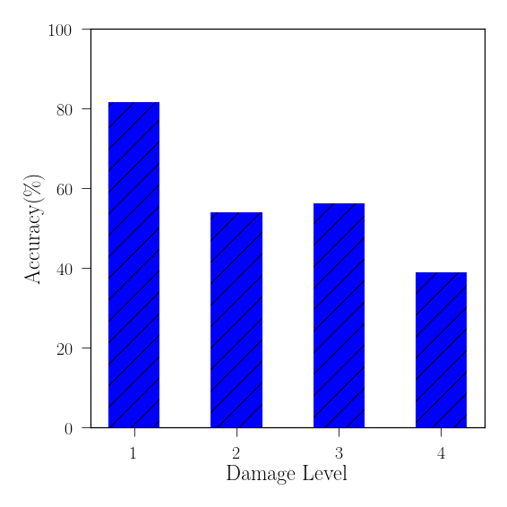
Training, validation, and testing results
Training and validation
Accuracy on unseen dataset
66.96%
0
1
2
3
Accuracy results from Literature:
Cheng et al. (2021) 61%
Zhou and Gong (2018) 78 – 82%
Pi et al. (2020) 74 – 80.7%
Presenter: Abiy Melaku

Slide 20
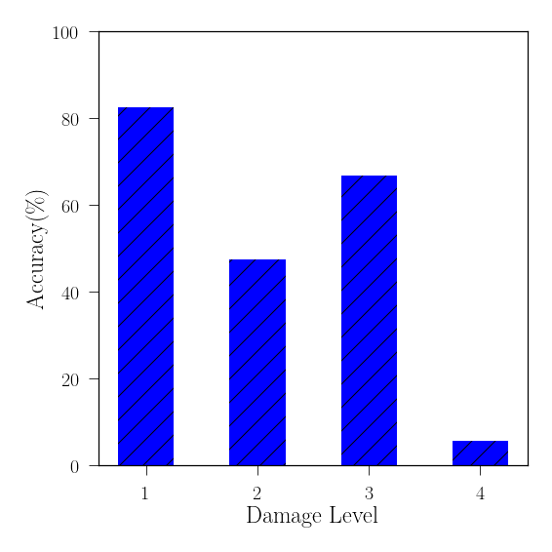
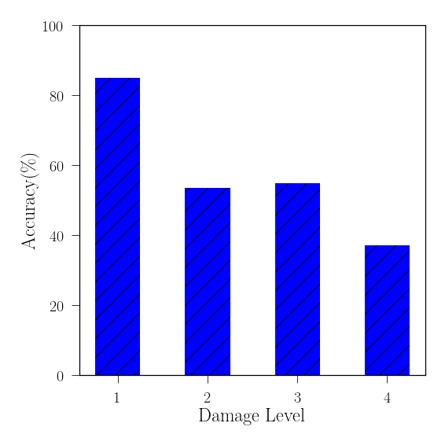
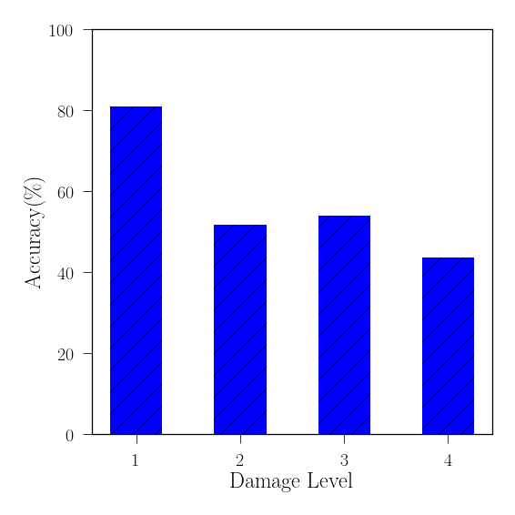
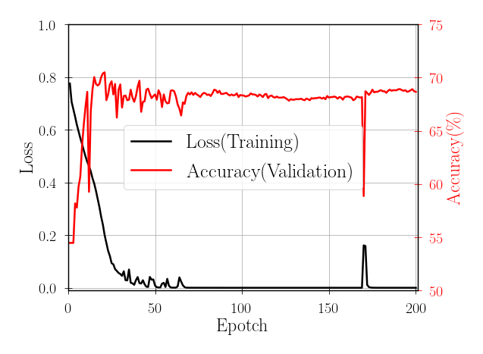
Network tuning results (Work in progress …)
Epoch = 20
Epoch = 100
Epoch = 100
Epoch = 50
Epoch = 200
Epoch = 200
Presenter: Abiy Melaku

Slide 21
Summary and future research
Presenter: Abiy Melaku

Slide 22
Summary
Completed tasks:
Data processing(open-source data)
Model preparation(CNN)
Training, validation and testing for selected hyper parameters
Upcoming tasks:
Implement cross-entropy loss function for ordinal data (0=no-damage –> 3=destroyed)
Tuning the model over various hyper-parameters
Comparison to previous studies
Future research:
Use of transfer learning to improve accuracy(i.e. ResNet)
Presenter: Abiy Melaku

Slide 23
Thank you! Q & A
Aaron John
Abiy Melaku, and
Tsinuel Geleta

